Slide 1
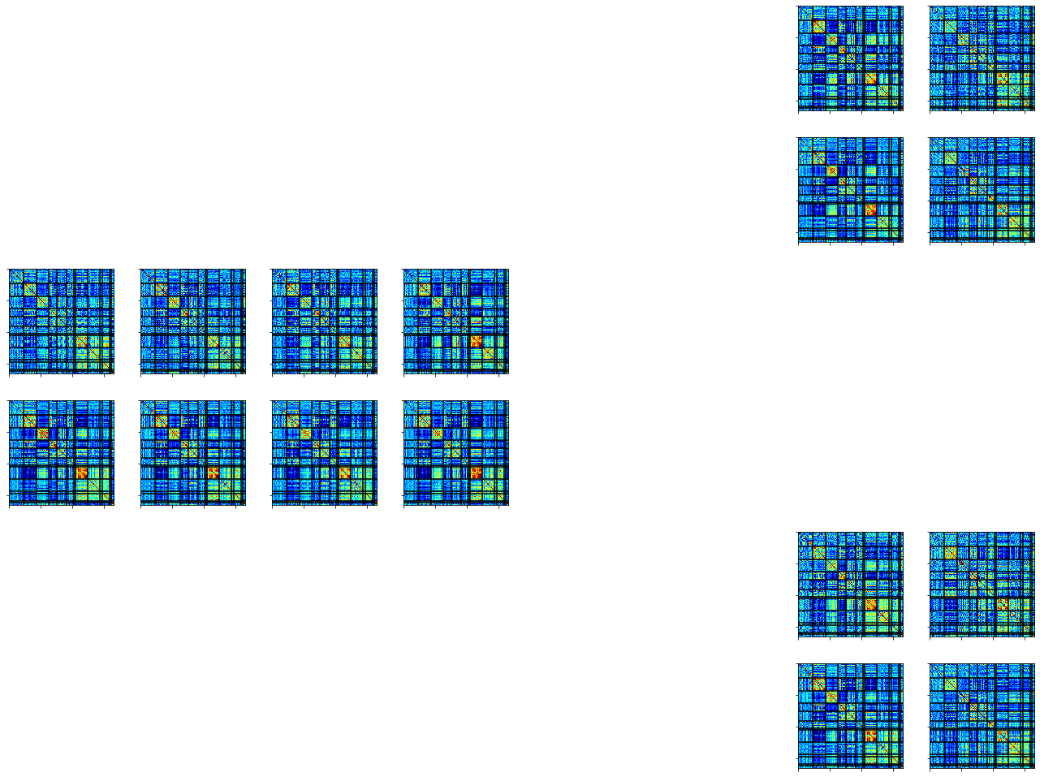
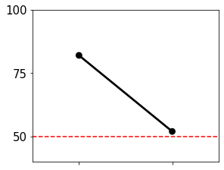
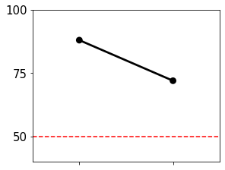
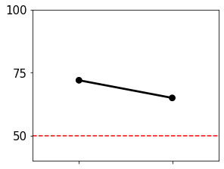
A.
Training
B.
Testing
MSC05
Task A
MSC04
Task A
Test
Task A
Rest
MSC04
MSC05
MSC04
MSC04
Task B
Rest
Rest
Task A
Task B
Session 10
Session 1
Session 2
…
MSC04
MSC05
Task B
Session 3
Session 9
Session 10
Task B
Rest
MSC04
MSC05

Slide 2
A.
Training
B.
Testing
C.
Evaluate
MSC04
Test
MSC04
MSC05
Task A
Task A
Task A
Accuracy %
Rest
MSC04
MSC05
MSC04
MSC05
MSC04
Rest
Task B
Accuracy %
Session 1
Session 2
…
Session 10
Session 3
Session 9
Session 10
Rest
Task A
Task B

Slide 3
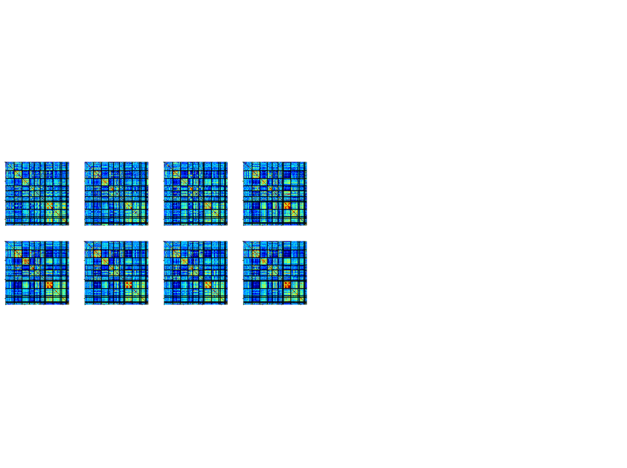


A.
Training
B.
Testing
C.
Compare
MSC04
MSC05
across person
MSC04
Task A
accuracy
Task A
Task A
Rest₁
MSC04
MSC05
MSC04
MSC05
across task
Rest
Task B
MSC04
accuracy
…
Rest₂
Session 1
Session 2
Session 3
Session 9
Session 10
Task A
Task B

Slide 4
A.
Training
B.
Testing
MSC04
MSC05
across person
MSC04
Task A
Task A
accuracy
Task A
Rest₁
MSC04
MSC05
MSC04
MSC05
across task
Rest
Task B
MSC04
accuracy
…
Rest₂
Session 1
Session 2
Session 3
Session 9
Session 10
Task A
Task B

